Slide 1
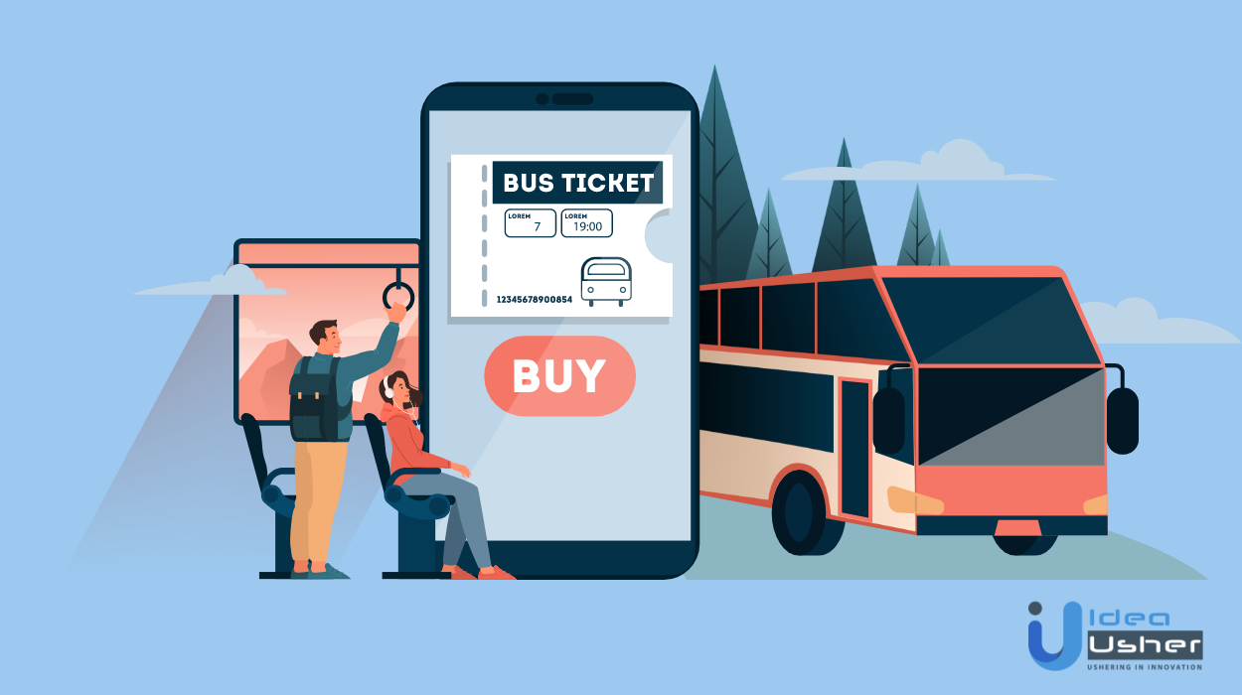
ONLINE BUS BOOKING SYSTEM

Slide 2
Project Team Members(Group 2)
Chetan kumar M Badiger 2491707
Chethan Kumar R 2495823
Dasannagari Harshitha 2492702
Devarala Thirupathi Rao 2490131
Dhanush K A 2491015
Dharanikota Sai Venkatesh 2491507
Eesha Rajendra Borkar 2490956
Gaddi Chetan 2492559
Garapati Prakash 2492335
Golla Sai Kumar 2492652

Slide 3
Contents:
Introduction
Why do we need online bus booking system ?
Objectives
Tools & languages used
System Requirements
Project flow
Features Available
Future Scope & Improvement
Advantages and disadvantages
Conclusion

Slide 4
Introduction:
Bus booking system is a java Spring Boot, MySQL and Angular Project which runs on the tomcat server, you can also run this project eclipse and Spring Tool Suites.
We have developed this java Spring Boot and Angular project on Bus Booking System for automating the process of Bus Booking System.
The main features on this project is to manage Bus, Seat Booking, Sales, Operations, Customer and Booking.
The Online Bus Booking System is a Web-based application that allows visitors check availability of buses, buy bus ticket and pay the bus ticket online.

Slide 5
Why do we need Online Bus Booking System?
We all know time is the most valuable thing in this world
An online bus reservation system helps people to book bus tickets or seats fromanywhere.
An online booking system mainly helps peoples who are busy with their ongoingprofession.
People do not need to travel to the bus counter physically for booking bus seats or tickets.

Slide 6
Instead, they can book bus tickets or seats instantly using an online platform.
We do get some great discounts while booking the bus tickets online and, you can even get cash back.
People don't have to wait for those long queues without any guarantee whether they will get their ticket or not.
In case of emergency traveling we, can even book our bus tickets online 1 day prior also.

Slide 7
Objectives :
Objective of this project is an application where the customer can book a ticket online and 24/7 hours a day from anyplace in the world.
Customers can also interact with the ticket booking website to know any other details they want. Online ticket booking system has developed successfully.

Slide 8
This is a user friendly application.
Through this application, the cost can be reduced and efficiency is increased.
With help of this application customers can book tickets, can know the status of bus.

Slide 9
Tools Used:
Front End : Angular
Server Side : Spring Boot
Backend : MySql,Hiberante
Server : TomCat

Slide 10
System Requirement
Hardware Intel Core i5
Speed-2.0 GHz
RAM - 4GB
Hard Disk 10GB

Slide 11
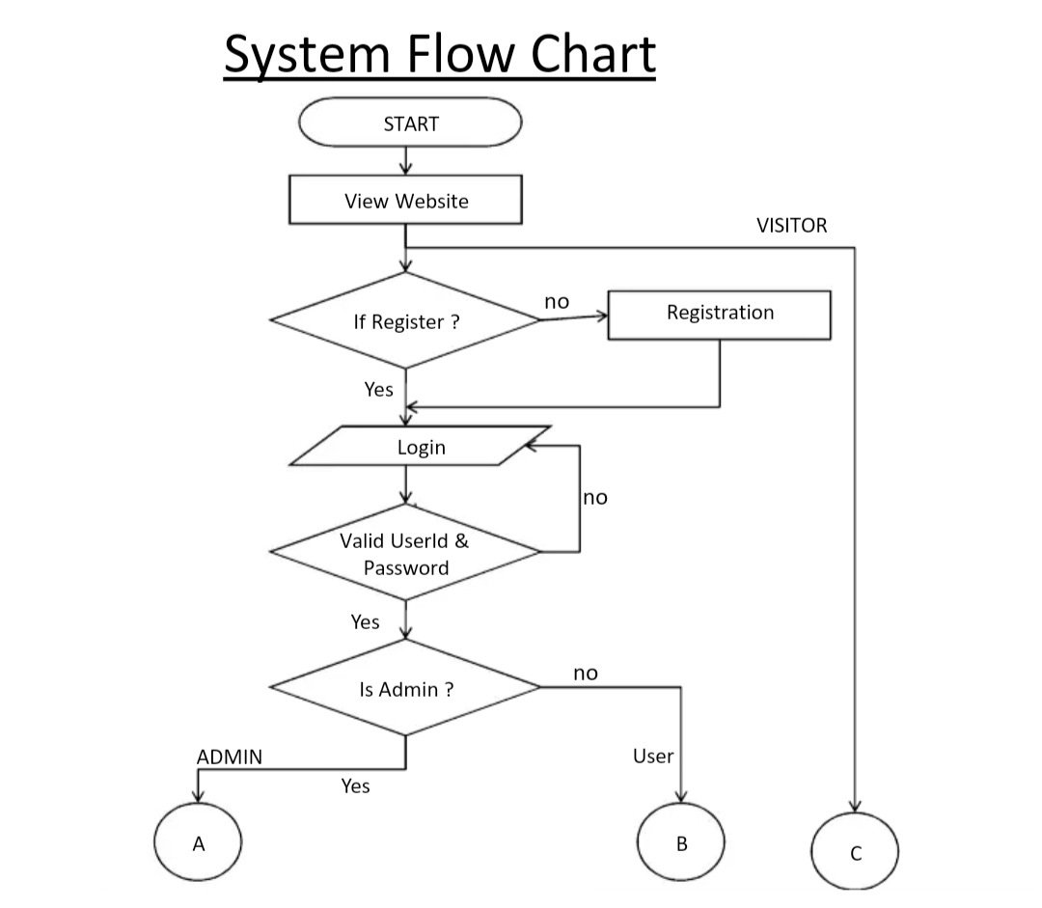
Flow Chart

Slide 12
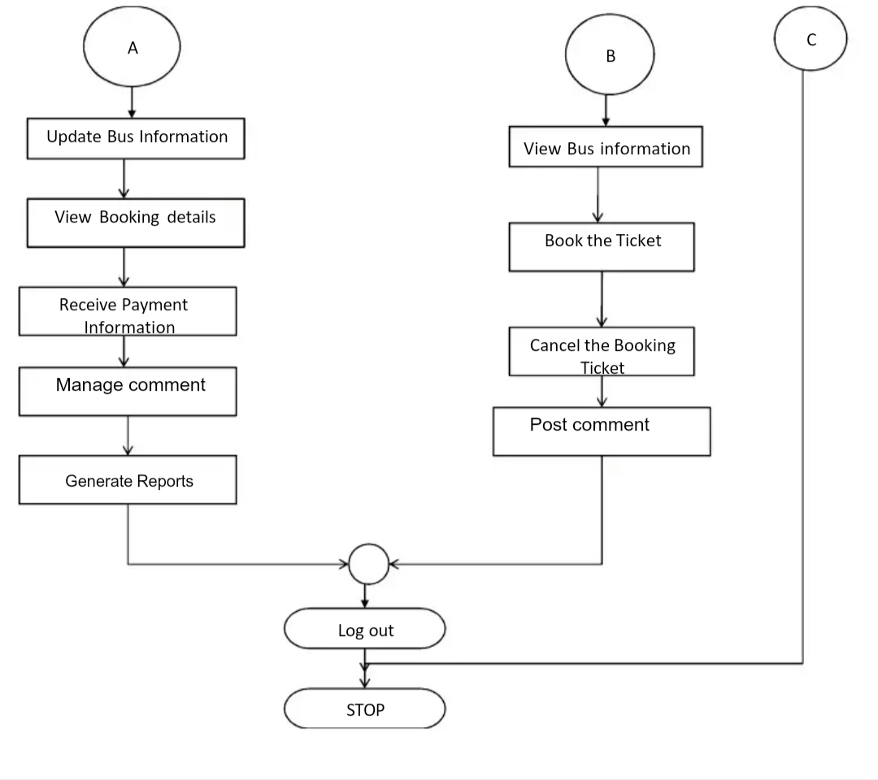
Continuation...

Slide 13
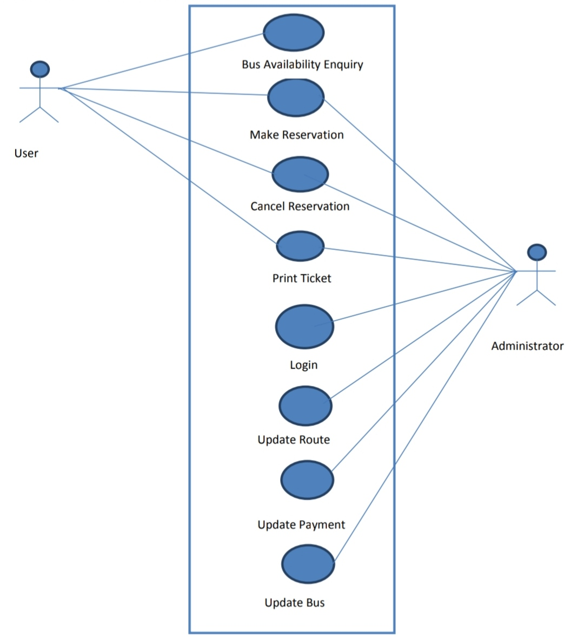
ER Diagram

Slide 14
Features
Online bus booking system
API Integration
Check seat availability
Control panel for admin and user.
User management

Slide 15
Future Scope :
The future scope of the Project is we can implement the live track of the route and the near by location available in the journey and sending the messages to person who booked before the journey starts.

Slide 16
Advantages :
Stress-free, hustle free booking of tickets.
Easy payment options.
You can have various options while choosing your tickets.
24/7 availability to accept reservations.
Amplifies booking process.

Slide 17
Disadvantages :
You need Internet Access to use Online Booking Systems.
No real contact with another human.
Software glitch can cause u buy same ticket twice... And den u have to contact Cust care and stress urself for reversal

Slide 18

Conclusion :
Online ticket booking system is an application where the customer can book a ticket online and 24/7 hours a day from anyplace in the world.
Customers can also interact with the ticket booking website to know any other details they want.
Online ticket booking system has developed successfully. System performance also found to be satisfactory. This is a user friendly application.
Through this application , the cost can be reduced and efficiency is increased.
With help of this application customers can book tickets, can know the status of bus

Slide 19
Thank You

